Slide 1
GENDER EQUALITY SURVEY GROUP MEMBERS: E.G.PRADEEP[RA2211004050026] V.SHAAM SUNDHAR[RA2211004050057] P.AGASH[RA2211004050028]

Slide 2
PURPOSE OF THE SURVEY The purpose of this survey is to gather meaningful insights and perspectives from individuals regarding gender equality, in alignment with Sustainable Development Goal 5 (SDG 5). Through this survey, we aim to: ⇒Assess awareness and understanding of gender-related issues. ⇒ Understand the experiences and opinions of respondents on equality in education, workplace, and society. ⇒ Identify challenges and barriers to achieving gender parity. ⇒ Gather suggestions and ideas from the community to foster a more inclusive and equitable environment.

Slide 3
SURVEY METHODOLOGY ⇒The primary objective of this survey was to assess the awareness, perceptions, and attitudes of individuals regarding Sustainable Development Goal 5 (SDG 5): Achieve gender equality and empower all women and girls. ⇒ The survey also aimed to gather insights on perceived barriers, personal involvement, and recommended solutions to achieve gender equality by 2030.

Slide 4
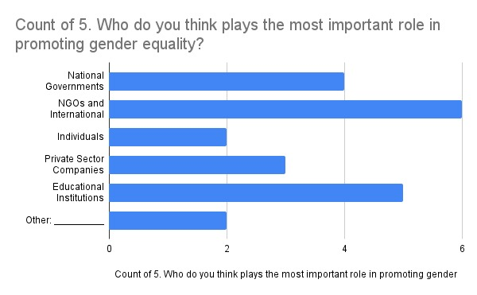

Slide 5
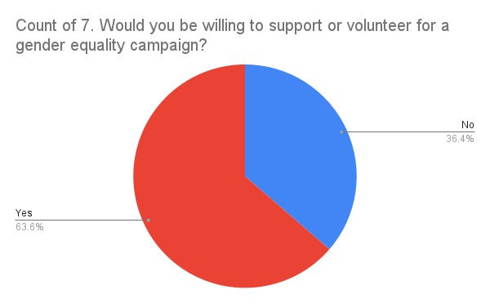

Slide 6
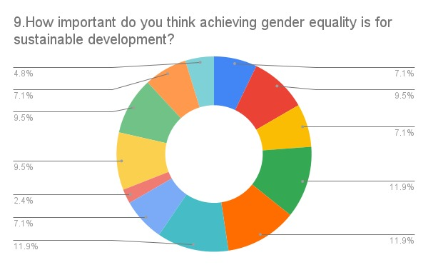

Slide 7
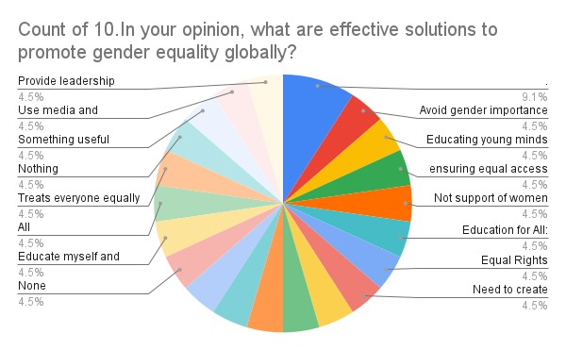

Slide 8
CONCLUSION ⇒High Awareness but Gaps in Specific Knowledge: While all respondents are aware of gender equality as part of the SDGs, nearly 20% are not familiar with SDG 5 specifically, indicating a need for more targeted education on this goal. ⇒Social Barriers Predominate: Gender stereotypes and violence/discrimination are perceived as the biggest barriers globally, highlighting the importance of addressing societal attitudes alongside policy measures. ⇒Moderate Engagement and Confidence: Participation in gender equality events and confidence in individual contributions are moderate, suggesting opportunities to boost public involvement and empower individuals to take meaningful action. ⇒Multi-Stakeholder Responsibility: Respondents recognize the crucial roles of NGOs, governments, educational institutions, and individuals, emphasizing that achieving gender equality requires coordinated efforts across sectors. ⇒Education and Awareness as Key Solutions: Education-both formal and through awareness campaigns-emerges as the most effective solution, alongside promoting equal rights, challenging stereotypes, and fostering leadership opportunities for women.

